Slide 1

walmart-store
Students: ibraheem alabed
جامعة الحسين التقنية
Al Hussein Technical University
H.T.U
FullStack PHP WebDevelopment
Supervisor:
Bisharah Estephan
Coh_9
2022/2023

Slide 2
Outline
Introduction
Problem Statement
Pictures from our project
Design Models
Demo

Slide 3
INTRODUCTION
In this project, we worked on developing a modern sales system that aims to help users complete sales and inventory operations with minimal effort and professionalism.
In this project, we studied the problems that users of the system might encounter in order to help them give more accurate and easier solutions.
Our project aims to complete sales and stock inventory of goods, and it also works to reduce errors that can occur in manual sales operations

Slide 4
Problem Statement
When opening a new store, users usually face problems with sales and accounts because of the large number of sales operations. Also, it is difficult to make an inventory at all times and know the number of goods available. Therefore, we have created a project that solves this problem and replaces the manual system with a completely electronic one.

Slide 5
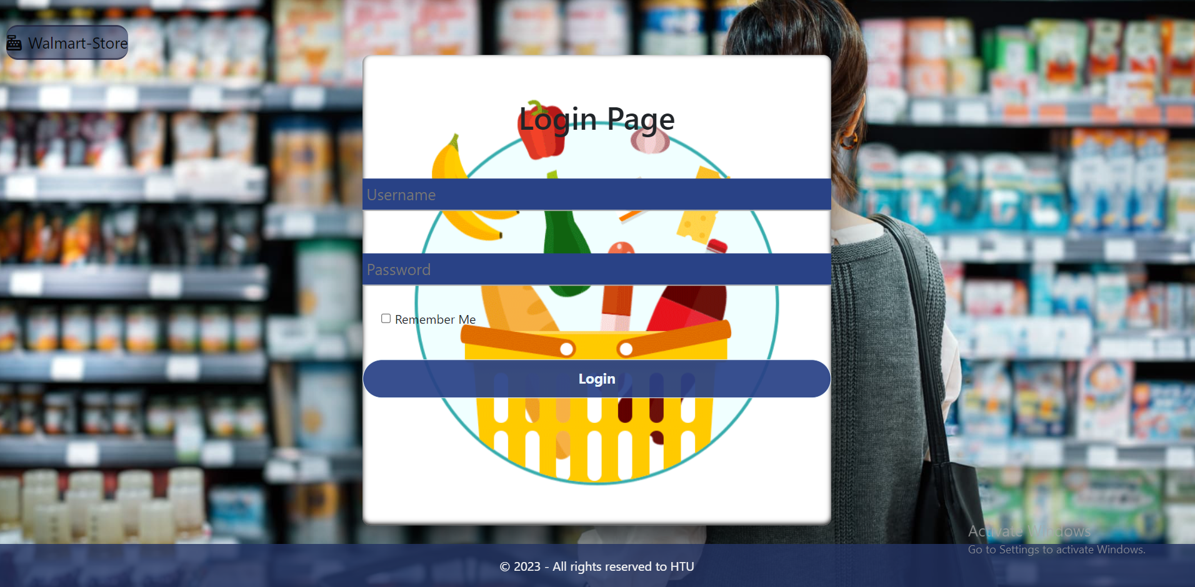
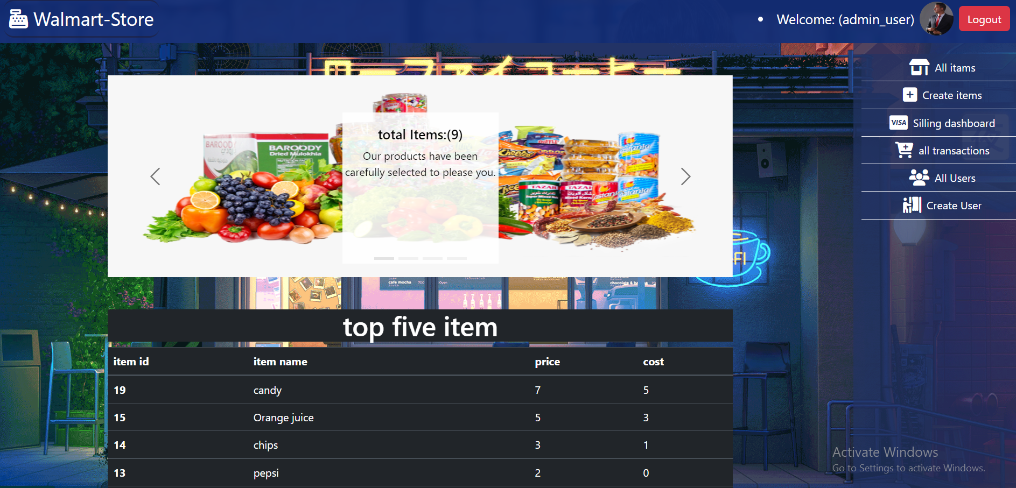
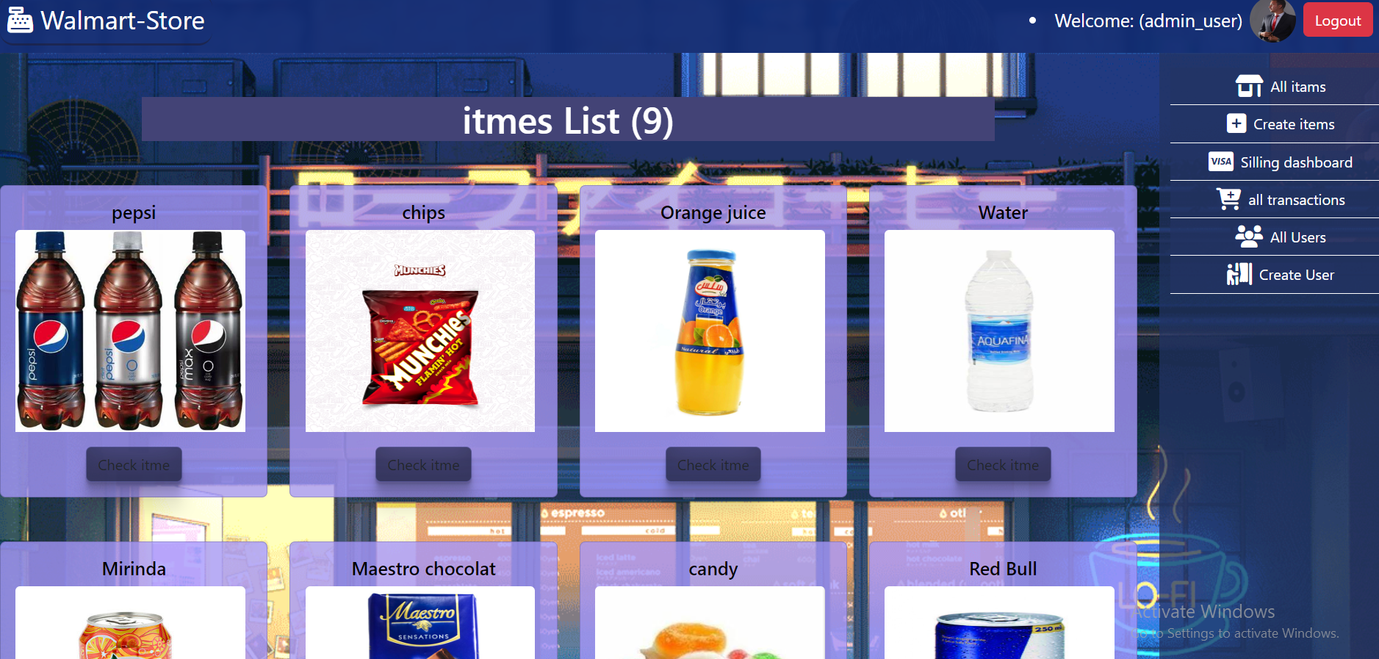
Pictures from our project

Slide 6
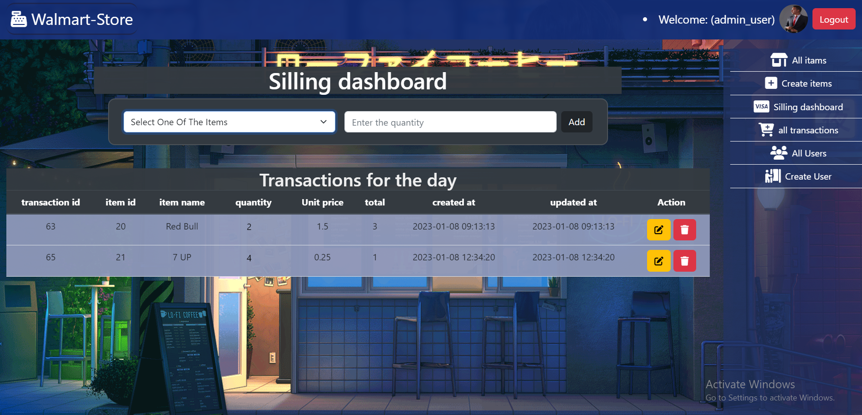
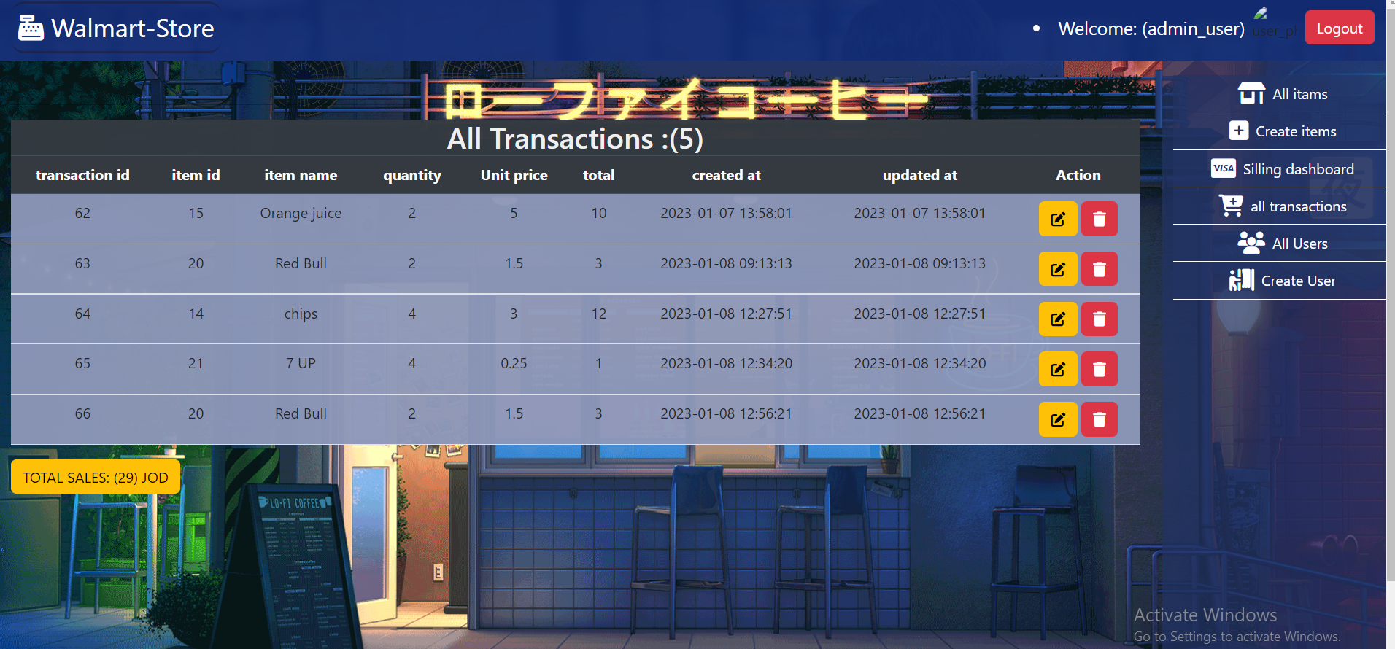
Pictures from our project

Slide 7
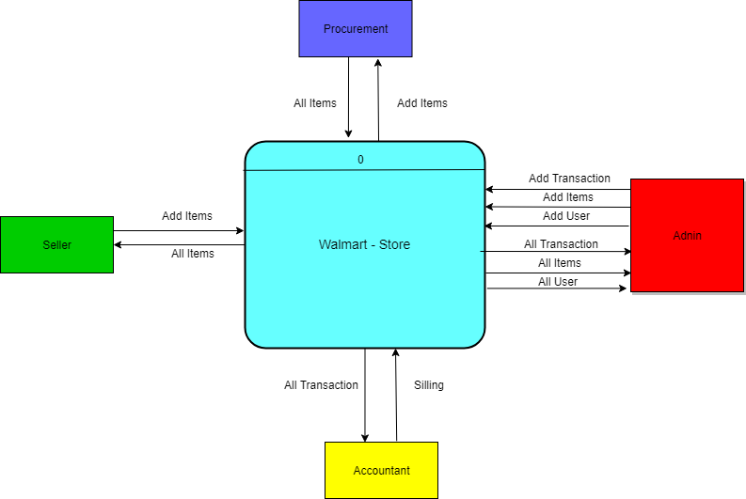
Design Model: Context Diagram

Slide 8
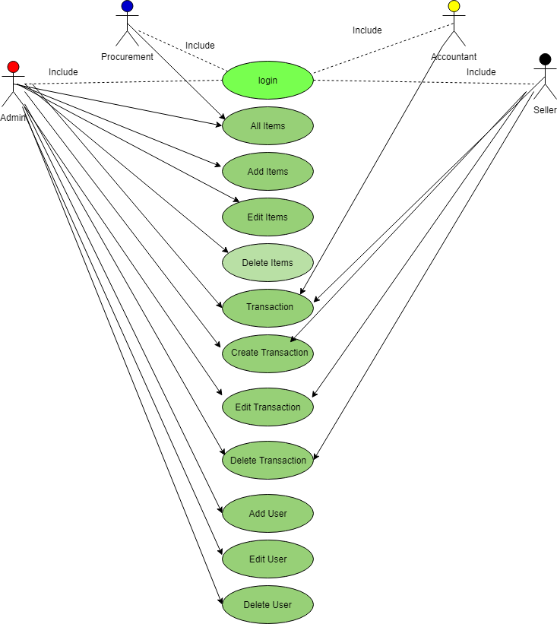
Design Model: Use Case Diagram

Slide 9
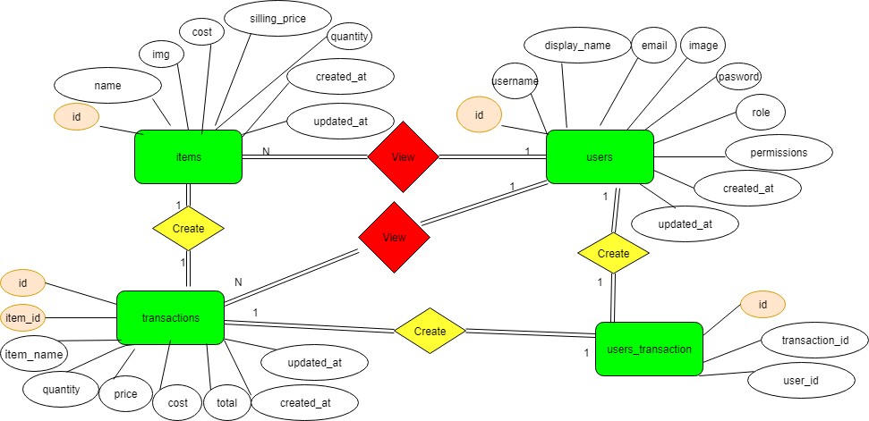
Design Model: ER Diagram

Slide 10
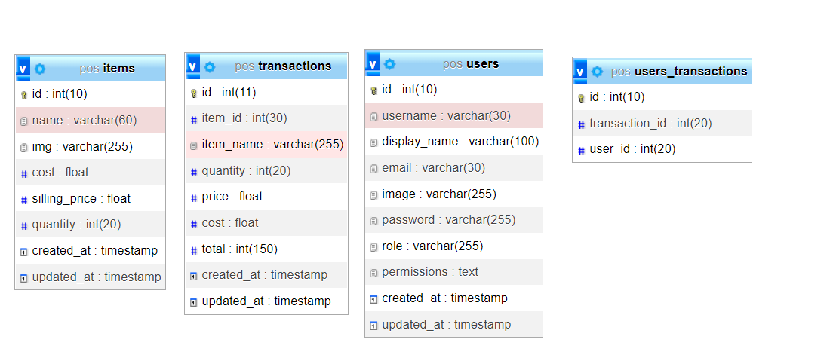
Design Model: Schema Diagram

Slide 11

Walmart-store

